Slide 1
CONFLICT, CONFLICT RESOLUTION AND PEACE BUILDING IN INDONESIA: MALUKU CASE
Delivered By:
Miryam Nainggolan
Fellow of
Asia Leadership Fellow Program
October 1, 2011

Slide 2
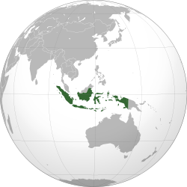
Republic of Indonesia
FLAG
Coat of arms
Motto : Bhinneka Tunggal Ika
(Old Javanese)
Unity in Diversity
National ideology : Pancasila
Anthem : Indonesia Raya

Slide 3
FACTS OF INDONESIA
PLURAL AND MULTICULTURAL COUNTRY:
Around 17,000 islands, 7000 uninhabited
Population: 237,556,363 (2010 census)
Around 300 different ethnic groups
Many religions (Islam is the biggest-more than 90%, Catholic, Protestant, Buddhist, Hindu, Kong Hu Cu, others)

Slide 4
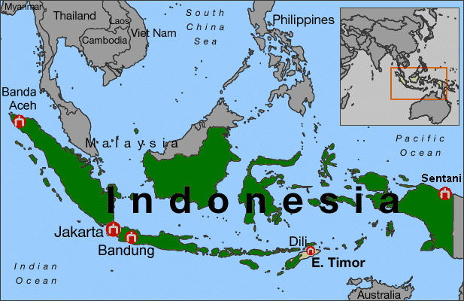
MAP OF INDONESIA

Slide 5
HISTORY OF RECENT SOCIAL CONFLICTS IN INDONESIA
Soeharto’s Era: 1966 – 1998:
Authoritarian New Order Regime
Under control : unification, tight censorship
Military approach: violence, military operation
Law as a tool of the government to oppress people
Conflicts happen in sudden ways, very violent, mostly between state/ military and communities
Conflict was systematically supressed, not publicised for fear to trigger sentiments of “ethnicity, religion and race among groups” (SARA)

Slide 6
HISTORY OF RECENT SOCIAL CONFLICTS (continued)
Some big conflicts in Soeharto’s era:
Killings and caught of the members of Indonesian Communist Party (1966-1967)
Military and Islamic Group (Tanjung Priok, 1984),
Closed Military Operation Zone in Aceh: starting around 1980
Closed Military Operation in Papua until now

Slide 7
HISTORY OF RECENT SOCIAL CONFLICTS IN INDONESIA
Political transition, May 1998- 2000: BJ Habibie (Soeharto’s successor) began process of power decentralisasion, reducing extensive reach of military into political and economical life; restructure of relationship between state and society.
Increasing role of civil society in peacemaking: change the relationship between military and police
Interacted with local grievances produced complex landscape of various conflicts: vertical and horizontal

Slide 8
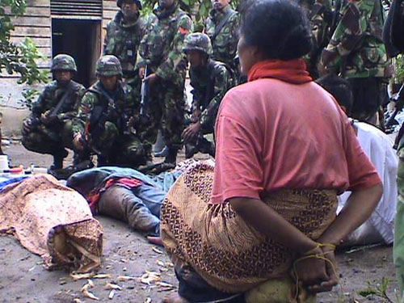
CONFLICT IN ACEH

Slide 9
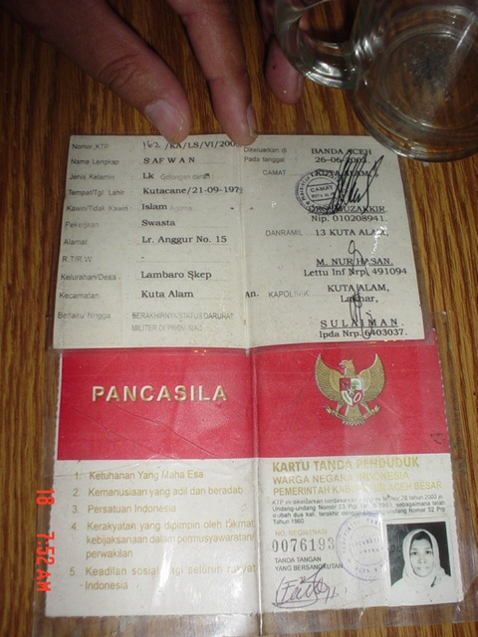

Slide 10
AFTER SOEHARTO’S FELL: 1998 - NOW
Increasing demands of democracy, democratic transition
Erupting of violent communal conflicts across the country: Ambon, Maluku (1999), North Maluku(2000),Western Kalimantan (1999), Central Kalimantan (2001), Poso-Central Sulawesi (2000) and many other smaller conflicts; 1,3 million IDPs (1999 -2003).
Emerging of civil society organizations: peace building, human rights, transitional justice, etc

Slide 11
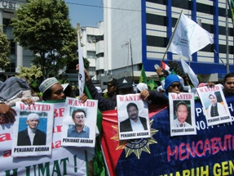
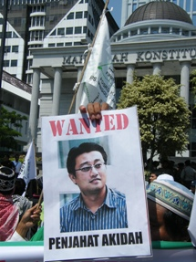
Fundamentalist group attack HRD in front of the Constitutional Court

Slide 12
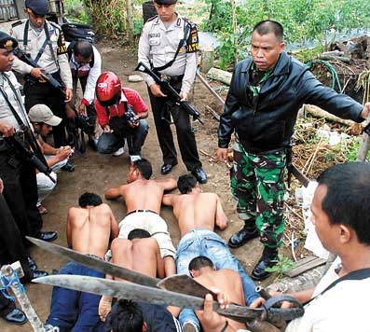
CONFLICT IN AMBON

Slide 13
MAIN SOURCES OF CONFLICTS IN INDONESIA (1999 – 2011)
SEPARATISM
INTRA AND INTER RELIGION AND ETHNIC
LOCAL POLITIC
LOCAL AND NATIONAL ELECTION
NATURAL RESOURCES
LAND DISPUTES

Slide 14
CONFLICT TREND IN INDONESIA FROM 2002 TO 2007

Slide 15
RANK OF CONFLICT FREQUENCY PER PROVINCE IN INDONESIA 2002 - 2007

Slide 16
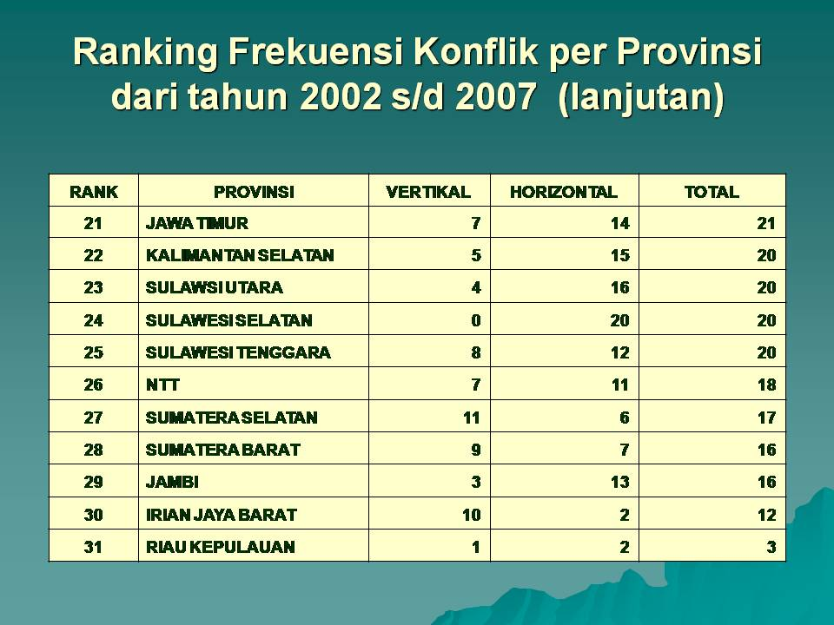
RANK OF CONFLICT FREQUENCY PER PROVINCE IN INDONESIA 2002 - 2007

Slide 17
CONFLICT, CONFLICT RESOLUTION AND PEACE BUILDING IN INDONESIA: MALUKU CASE
MALUKU’S CASE (1999-2002)
Violent conflict between Muslims and Christians
Year 2000 census, Christians in Maluku is 52%, compared to 88% of Indonesian population is Muslim).
Largely concentrated in Ambon, started in January 19, 1999, spread to other islands in Maluku.
Almost 5000 died, 1/3 of population were displaced
CONFLICT DRIVERS:
Longstanding tensions between Christians and Muslims

Slide 18
MALUKU CASE:
- Dutch colonialism for 350 years divided Maluku society
along religious lines, geographically and socially. Christians had greater access to education and political office, Muslims majority were traders and businessmen
During Soeharto’s time: imposed superficial peaceful relationship between Christians and Muslims, appointed Muslim as Governor of Maluku in 1992 followed with all regents were Muslims in 1996 ----further divided the society along religious lines
Government transmigration policy began in 1950’s, voluntary migration from Bugis, Buton and Makassar grew in 1970’s, changed the composition of Christians and Muslims population

Slide 19
MALUKU CASE
CONFLICT ESCALATION, TRIGERRED BY:
Rumours surrounding religious symbols(attacks on mosques and churches)
Win of the Indonesian Democratic Party-Struggle (PDI-P)
in election in Ambon;PDI-P was perceived as “the Christian party” in Maluku (July 1999)
Security forces divided along religious lines, unable to perform their tasks
Peak of conflict: SILO Church in Ambon, the biggest Maluku Protestant Church (GPM) was attacked and burnt and the massacre of 800 Muslims in the mosque at Tobelo village in North Maluku, killed by the Christians (December 26, 1999).

Slide 20
MALUKU CASE
After the massacre at Tobelo, more than 100,000 Muslims held a protest in Jakarta (Jan 7, 2000) to call JIHAD for Maluku, followed by a creation of “Laskar Jihad” (Jihad Warriors), Java-based Muslim militia- led by Ja’far Umar Thalib, leader of Muslim organization, FKAWJ). In May 2000, they started come to Maluku. Stole 800 weapons from a police weapons store. More Christians than Muslims villages attacked.
State of CIVIL EMERGENCY was declared in 27 June 2000,
17 army battalions plus 2 batallions of paramilitary police were deployed
Problems of co-ordination between military and police

Slide 21
MALUKU CASE
CONFLICT RESOLUTION/MANAGEMENT EFFORTS
SECURITY AND EMERGENCY APPROACH (Peace Keeping):
- Military mobilised from outside Maluku
- Upgrade the Maluku District Military Command (KOREM) into Regional Military Command (KODAM)in May 1999 with greater status and budget
- In fact, increased force did not decrease violent conflict, military inexperienced with communal conflict
- Civil Emergency declared in 27 June 2000 and lasted May 2003 in North Maluku Province and September 2003 in Maluku Province

Slide 22
MALUKU CASE
2.RECOVERY AND DEVELOPMENT APPROACH
International and local NGOs provided humanitarian aid: sanitation, medical care, basic neccesities to IDPs
Local NGOs in Ambon established a consortium called Maluku Social Humanitarian Voluntary Team
Segregated local NGOs providing aids to their respective communities.
Local community efforts (church, mosque)

Slide 23
PEACE BUILDING EFFORTS AND ACTORS L
Local Community : “TEAM 20” in Wayame Village
BAKU BAE Peace Movement: ceasing the violence by forging a common identity between both groups as victims of violence, developed and built by civil society actors: scholars, NGOs activists, lawyers, journalist, religious representatives, village and traditional leaders (raja), facilitated by peace activists from Jakarta.
MALUKU MEDIA CENTER: as a result of Baku Bae series of Workshops in Jakarta in 2001
MEDIA: peace journalism
WOMEN: most active at the grassroots level; Caring Women’s Movement was formed in Sept 1999 by more than 40 Muslim, Protestant and Catholic women activists

Slide 24
PEACE BUILDING EFFORTS AND ACTORS
MALINO II Peace Agreement :
Peace process initiated and led by Central Government
69 communities representatives (35 Muslims and 34 Christians, inc 3 Christian women)gathered 3 days.
Signed in 11 February 2003 in Malino, South Sulawesi, draft prepared by central government, reviewed and edited only in day 2, signed in day 3
Rapid process, lack of much engagement of representatives

Slide 25
PEACE BUILDING EFFORTS AND ACTORS
MALINO II Peace Agreement :
Religious leaders were not consulted
Considered important peace agreement: strong political to reduce violence
Established two joint commissions: 1. monitor law and order, 2. oversee social and economic conditions, but poorly implemented
Any acts of violence treated as crimes and subject to the legal process (law enforcement)
Peace remains fragile; the root causes of conflict were not addressed and new grievances have emerged.

Slide 26
PEACE BUILDING EFFORTS AND ACTORS
POST - MALINO II PEACE AGREEMENT:
Government Initiatives: rehabilitation and reconstruction of Maluku and North Maluku by the Presidential Instruction No.6 21 Sept 2003 ( USD 130,6 million plus USD 26,9 million for IDP-related activities would be allocated in2005); lack of accountability and transparency, misuse/corruption
Internally displaced persons, problems in delivering aid to IDPs: to lack of reliable data and information, corruption in funds management.

Slide 27
PEACE BUILDING EFFORTS AND ACTORS
Divisions and creation of new provinces, districts and sub-districts (Local Autonomy Law, 1999)helped decrease violent conflict
Law enforcement: some key figures from both groups were brought to trial, suspected members of local terrorist groups/militia were arrested
Civil society played role to restore social cohesion between religious groups, interfaith organizations encouraged interfaith dialogue and promoted interaction between Christians and Muslims.

Slide 28
PEACE BUILDING EFFORTS AND ACTORS
International NGOs more active in reconciliation activities, especially with IDPs but limited success due to lack of experience of their local NGOs partner
Peace Education by UNICEF :
- With GoI supported local education department developed joint peace education/psychosocial curriculum adapted to local context in Maluku and North Maluku
- Developed a syllabus for teachers in 2004, mainstreaming peace education into 4 subjects for senior high school students
- Training 40 teachers from10 schools using this syllabus
- Joint UNICEF-UNESCO website on peace education in 2004

Slide 29
PEACE BUILDING EFFORTS AND ACTORS
- Peace building & reconciliation events: sports for peace, science exhibition, commemorate International Day of Peace in 2005.
Revitalisation of adat: customary laws, unwritten traditional code regulating social, political and economic activity and resolution of disputes.
Many donors and INGOs left Maluku after tsunami in Aceh, Dec 2004 and earthquake in Yogyakarta, 2005; local NGOs difficult to access funds for post-conflict recovery inc.peace building programs.

Slide 30
CHALLENGES IN CONFLICT TRANSFORMATION IN MALUKU
Structural problems are not handle properly:
Segregation of Christian and Muslim communities, land and property disputes among IDPs, religiously divided NGOs, unemployment, increased migration from Java.
Local government has not succeeded in developing policies to deal with the structural problems

Slide 31
CONFLICT HAPPEN AGAIN IN AMBON in September 11, 2011
Because of the unresolved the roots of the problems, potential conflict is still remaining in Maluku
Communal conflict happen again in Ambon in 11 September 2011.
Data per Sept 12, 2011: 5 died, 184 injured and hospitalized, 70 houses burnt, 5 cars and 5 motorcycles destroyed/burnt
Impact of NGOs’ work: more resilient communities, more community awareness, not easily to trust rumors, interfaith groups play roles as “peace provocateurs”.

